Slide 1

A Peer Taught Cannabis Education Program
Emma Wilson, MPH
Prevention Educator II
Notes:
Intro to who I am, education background, what my typical day is as prevention educator/managing this program, certified as a prevention specialist with the state of MO
*explanation of title here? (lots of misinformation; state and federal laws differ, still so much we don’t know, etc.)

Slide 2
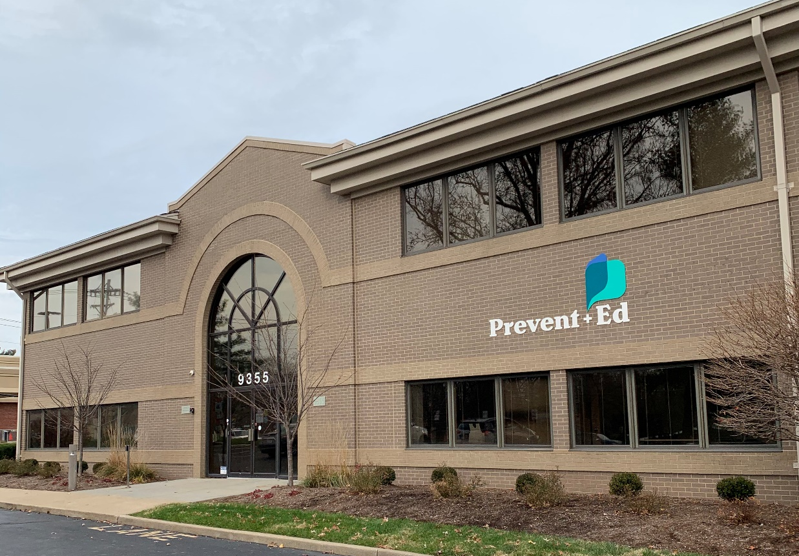
PreventEd works to reduce or prevent the harms of alcohol and other drug use through education, intervention and advocacy.
Notes:
Formerly NCADA (National Council on Alcoholism & Drug Abuse)
Prevention resource center of eastern MO; we cover St. Louis City, St. Louis County, St. Charles, Jefferson, Franklin, Warren, and Lincoln counties

Slide 3
Background
Initiation of cannabis use often begins during the high school years.¹
High school students are at risk of experiencing various consequences from cannabis use.²
School-based interventions and programming have the potential to reduce risky cannabis use.³
Most of the existing programming did not reflect changes in the legal status of cannabis in many states across the U.S.^{4,5}
Notes:
For instance, in data from the National Survey on Drug Use and Health survey, annually reported by team at SAMSHA (substance abuse and mental health services admin) over 2.6 million people initiated cannabis use in 2021 and over 75% of these respondents were under the age of 26, 60% were under the age of 21
This is of concern because the brain is still developing; the brain is more vulnerable and susceptible to the deleterious effects of cannabis use. Various consequences including cannabis use disorder, overdose
17% of teens who use cannabis will develop a CUD (1 in 6); *should I mention that the primary substance in adolescent diagnosis is cannabis?
Of all youth age 12-17 in drug treatment, nearly 62% had a primary cannabis diagnosis; approx. half referred to treatment through criminal justice system and half through other sources including self-referral
Overdose or “greening out”, 11 hydroxy THC
Side effects: nausea/vomiting, psychosis, panic, rapid heartrate
Easier accessibility, they think the other methods of ingestion outside of smoking are “safer” when in reality these products have more THC
Likely to happen with THC concentrates such as carts (cartridges) that are vaped, dabbing waxes and oils, and edibles. These are the average THC levels:
Cannabis Plant: 10-35% THC
Cannabis Concentrates: 40-90% THC
*Should I mention that the potency is increasing? 1995=3.96% THC, 2021=15.34%
The attitudes then is not a resemblance of the risk today
*comparison to alcohol content programs, like TryPOD? In a meta-analysis of 17 studies analyzing school-based alcohol prevention programs, researchers found a significant decrease in alcohol consumption amongst adolescents who received the intervention or program; we expected a similar program but replaced with the topic of cannabis might yield similar results, minimizing cannabis use amongst teens
Last bullet point . . . curriculum has not been updated with the times; talk about the thick dusty binder
Last bullet point . . . Recreational: This study's findings suggest that although marijuana legalization advanced social justice goals, the small post-RML (recreational marijuana legalization) increase in risk for CUD among respondents aged 12 to 17 years → confounding variable could be there is more acceptability about being assessed
Normalizes, reduces perception of harm, eases access
Increased rates of intensity

Slide 4
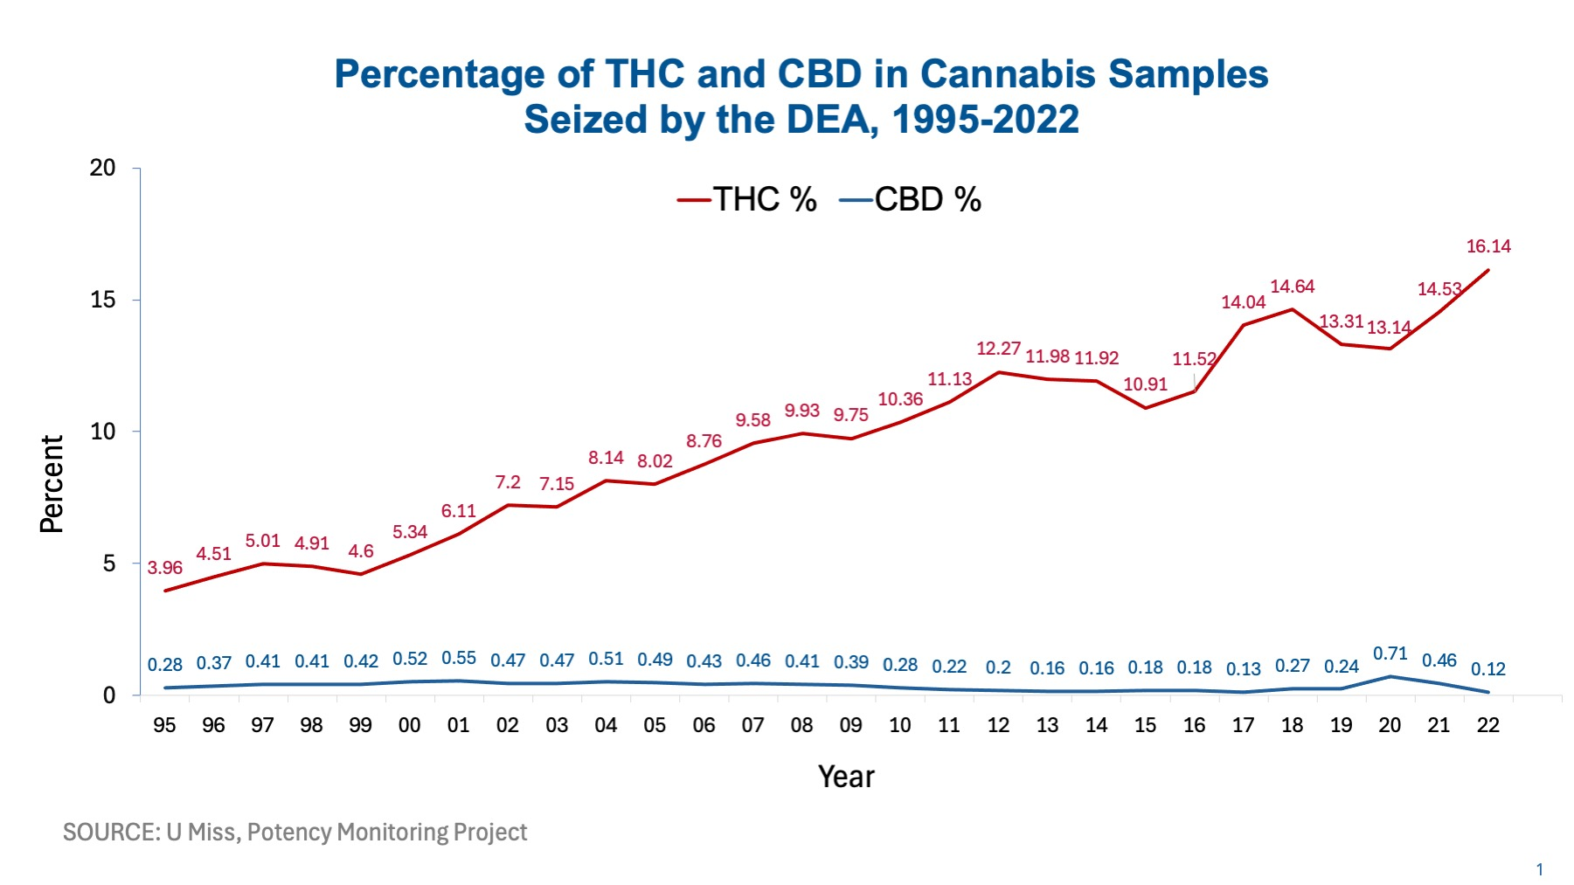
Notes:
Flip back to background

Slide 5
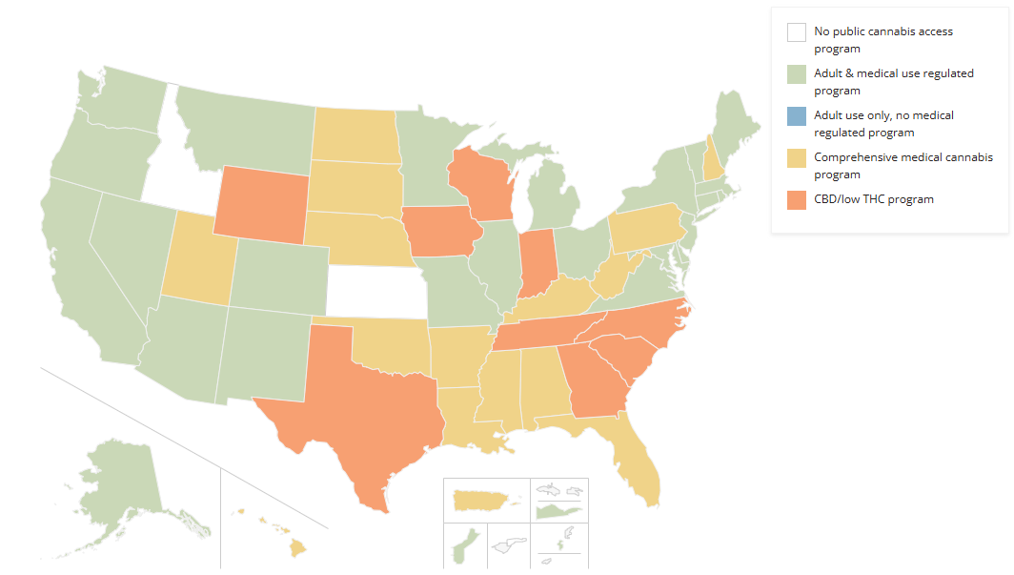
National Landscape
Source: National Conference of State Legislatures. (Updated Feb 1, 2025)

Slide 6
Missouri Landscape
Medicinal
November 2018
via
Constitutional
Amendment
Adult use
November 2022
via
Constitutional
Amendment
Notes:
Medicinal: 39 states, plus DC & 3 territories
Adult/recreational use: MO was the 21st state (22 states as of May ‘23, 2 territories and DC), posses up to 3 oz dried/unprocessed (there is another weighing system for things that aren’t sold in flower form, ie. gummies), at least 21 years of age
Criteria or conditions under each law; not just free game (ie. age, feet from school,
Changes are very difficult because it’s a change to the constitution; since a decision could not be made by legislators, so it was up to the voters to decide; so if any adjustments need to be made

Slide 7
Missouri Teens
In 2024, 32.2% of MO high school students perceived ‘no’ or ‘slight risk’ if they smoked cannabis 1-2x per week.⁶
US: National Surveys on Drug Use and Health 2023
% of 12-17 y/o who have ever tried cannabis: 13.4% % of 12-17 y/o who have used cannabis in the last 30 days: 6%
Missouri Student Survey 2024
% of 6-12 graders who have ever tried cannabis: 12.7% % of 6-12 graders who have used cannabis in the last 30 days: 7.3%
Notes:
2022 Missouri Student Survey Results
Since 2000, 6th-12th graders, every even year. County reports are available. The numbers above represent statewide numbers
Ask, if these numbers are higher or lower than anticipated
In Missouri (2024) of students who used it within the last month, about a quarter of those students use daily. Over half who have used reported getting the product from a friend (53%) followed by a family member (28%)

Slide 8
Risk Factors
CUD
Early experiment-ation
Younger age of alcohol & nicotine use
Parents misuse
Easy availability and frequency of use
Poor school performance
Poor self concept
Difficulties coping with stress
Oppositional behaviors
Childhood sexual abuse
Notes:
(average age of first cannabis use in MO is 14.6)
Goal of prevention is to shift the balance. Minimizing risk factors while developing protective factors.
Like all diseases, there are certain things that put a person at risk for addiction.
Before showing the rest, ask what are some things that you think could put someone at risk for addiction?
Remember, risk means “chance” so, while having one of these risk factors certainly increases your chances, it doesn’t necessarily mean that if someone has one of these, that they will become addicted. The chance is there. The more risk factors, the more chances for addiction. So, the possible risks should be considered when making a decision.
Ask:
Which risk factors do we have control over (which do we not)?
How could we decrease some of these risk factors?
Stronger predictors? Genes, Peer/Social Group, Early Experimentation, Behavior Problems One of the greatest predictors of someone having an addiction later on is EARLY USE!! Not all teens who experiment with substances will necessarily develop a SUD, but because their brains are still developing, their brains are more vulnerable to the negative effects of drugs. Damage to their brains can happen quicker and can be more severe than with an adult brain AND your brains can get addicted to substances much faster than an adult brain. *can I use the two house example?
On the flip side, there are things that can help reduce the risk for addiction that are called protective factors.
Strong family ties
Academic success
Trusted adult
Healthy coping strategies
Safe housing
Spirituality
Positive social involvement; positive peer group*** explain that we do this in our program
Notice there are many more protective factors than risk factors-
Protective factors can be increased to reduce substance use once initiated as well.

Slide 9
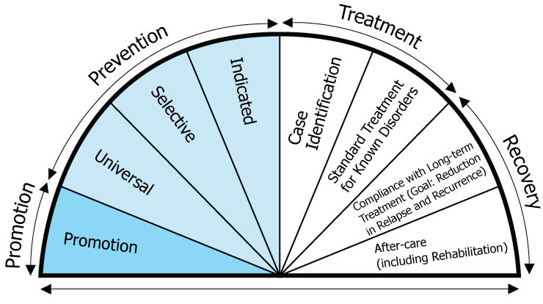
Continuum of care for substance use disorders
Notes:
All of these need to work in conjunction
Universal prevention
Most of what we do is prevention universal and recovery, happy to talk to you about the little piece of indicated, w

Slide 10
Origins of It’s Complicated
In 2017, PreventEd (then NCADA-STL) received funding from the Missouri Foundation for Health to develop, deliver, and evaluate a cannabis education curriculum in Missouri high schools.
Identified two schools to pilot the curriculum, and one (Hillsboro High School in rural Jefferson County) as the test site.
Notes:
Uniqueness of this grant: program development, implementation, and evaluation from MO Foundation for Health
Originally 4 lessons, thinking about the names, Affton and Hillsboro, both schools had a proven track record of peer education
Hillsboro did a killer job with TryPOD, kids from TI wanted to lead; great relationship with school admin
Affton also had hungry TI kids, did a lot with HiStep
Both schools understood peer education and kids that wanted to do it and it helped immensely with recruitment
When we did the pilot we actually felt the sponsor at Hillsboro were awesome and mutually beneficial because they could have positive attention ; shows what you really need is a group of kids who want to do it but you also need a dedicated sponsor, admin buy in

Slide 11
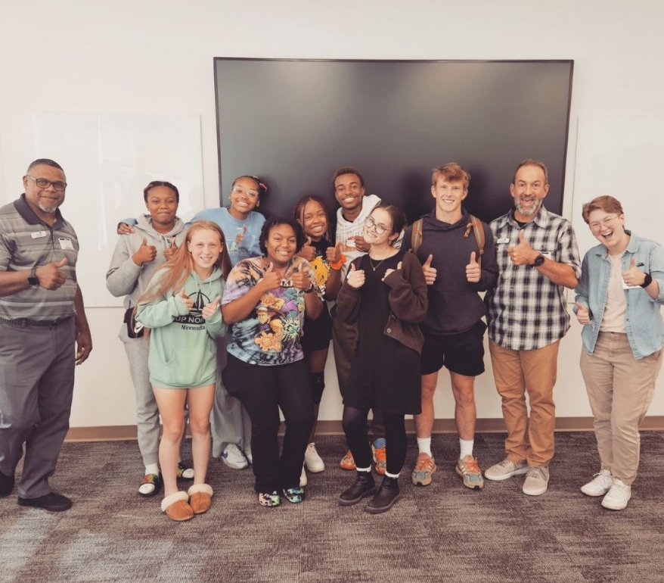
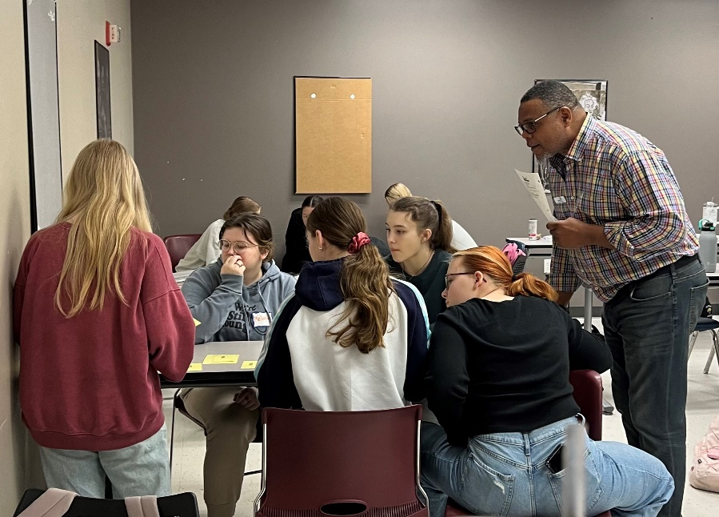
Peer Teacher Training
6-hour training for upperclassmen*
LOTS of food
Content, but also teaching fundamentals
PRACTICE!!!

Slide 12
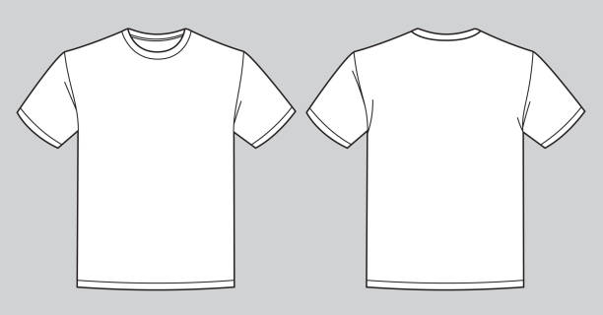
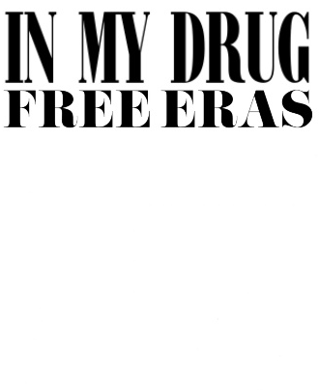
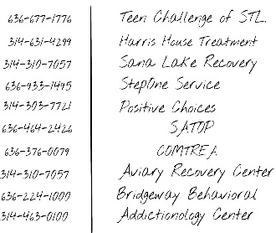
Why the Peer Model
Fosters the protective factors of positive peer groups and school connectedness
Students retain more concepts and their perception of risk increase when taught by their peers
Notes:
*who is going to mention the why to peer education? Could I mention on introduction slide? (Research has shown that teens learn about 10-15% more from their peers than from adults; young adolescents trust their peers more than adults when assessing risk; also the peer educators themselves retain more concepts since they have to turn around and teach the info, I was reading a study that revealed a student who had to answer a question independently vs a student that could answer a question after collaboration, had over 1.5x greater odds of being correct, that is what’s cool with peer education, peers can fill in each other’s gaps to offer a wealth of knowledge to their peer students.)

Slide 13
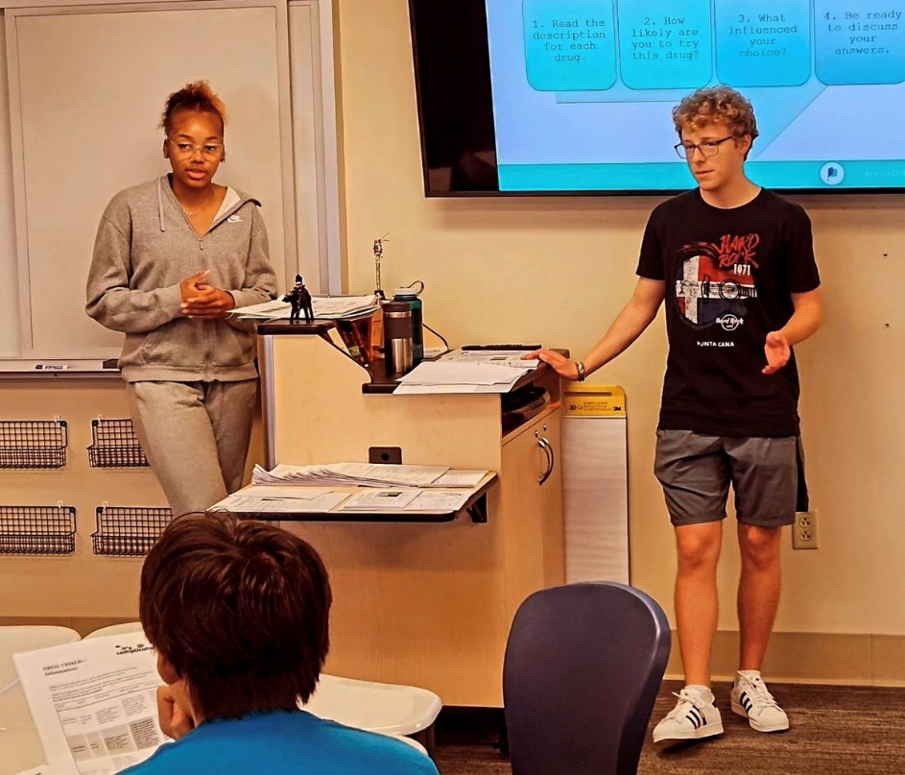
Curriculum Design
It’s Complicated Curriculum Design
Delivered by peer teachers in 9th grade health class*
  Lesson 1: Navigating the Cannabis Dilemma
    The science of cannabis (THC vs. CBD)
    Adult use vs medical use
  Lesson 2: What’s the Big Deal?
    Reality behind industry marketing strategies
    Effects of cannabis on the teen brain
  Lesson 3: Now What?
    Mental Health Implications
    Navigating risks (build appropriate coping skills)
    Expressing concern about friends
Support from PreventEd staff and the school sponsor
Notes:
Originally planned as 4 sessions → consolidated to 3 sessions to improve fit with the class schedule.

Slide 14
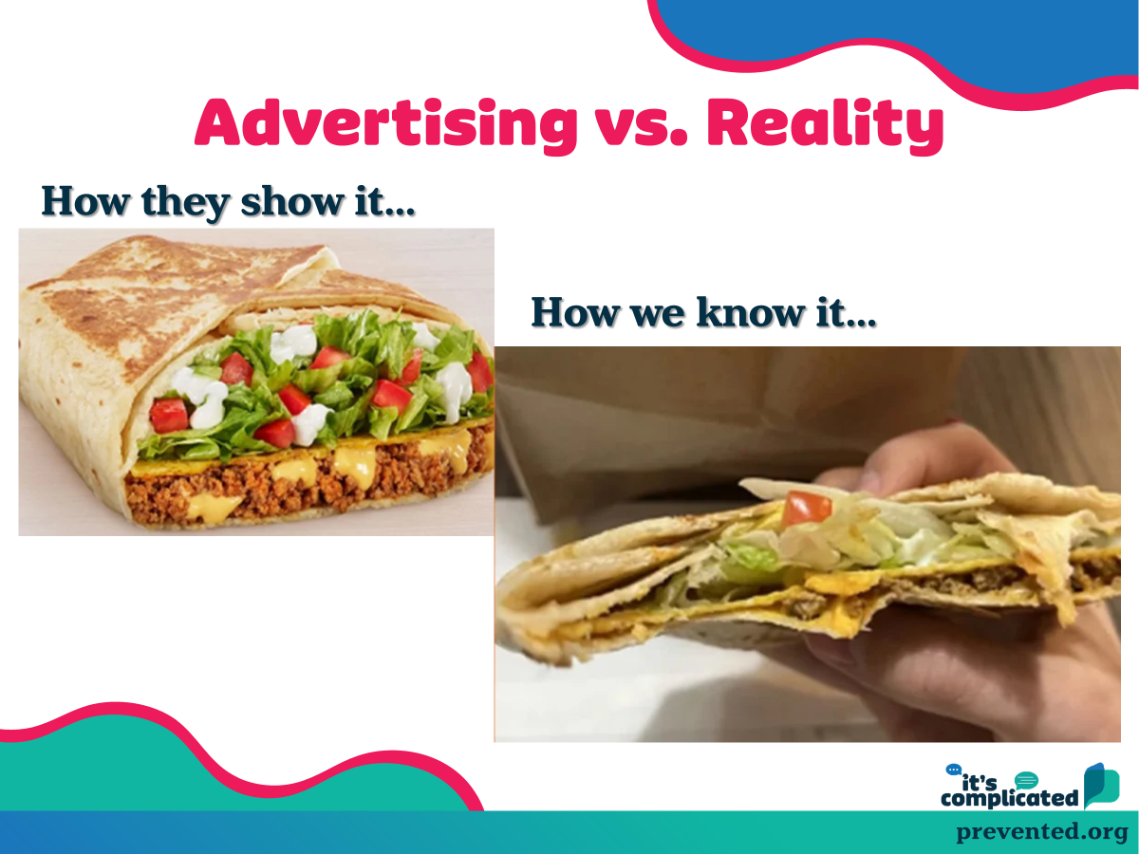
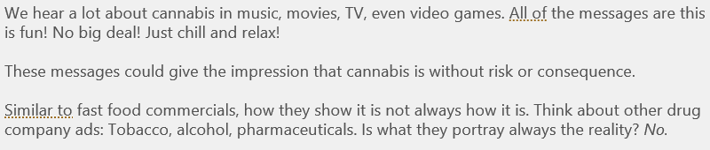
Lesson 2: Slide Example
Every lesson contains:
-Evidence from scientific
literature
-A hands on activity
-A video
-Take home information for
each student

Slide 15
Administrative Buy-In
It does seem cannabis content-heavy; however, health students and involved upper-level students:
Analyze the influences that affect health and well-being,
Assess valid and reliable resources,
Learn how to use interpersonal communication skills,
Leverage the decision-making process to support personal and community health and well-being,
Learn to advocate for personal and community health.
Notes:
Based on national health education standards

Slide 16
evaluation & Outcomes

Slide 17
Evaluation Methods
Cluster-randomized, delayed intervention randomized trial.
At the beginning of each semester, health classes were randomized to receive It’s Complicated either: (a) Early, or (b) Later in the semester.
A series of surveys were conducted among all classes (three survey waves administered on the same schedule).
Three semesters: Fall 2019, Spring 2020, Spring 2021.
COVID disruption and adjustment.
Notes:
After determining that a traditional RCT would be impractical, a cluster-randomized delayed intervention trial was chosen
In a traditional randomized trial, we randomly assign students to groups; randomization occurs at the individual level.
Not always practical in a school setting
Cluster-randomized trial simply means that we assign groups of students to the experimental or comparison groups
In schools, classrooms are a natural unit of clustering

Slide 18
Evaluation Methods (cont.)
Because the school adopted the curriculum as part of the standard health class and student surveys were de-identified, the Western IRB determined the study to be exempt.
Nevertheless, written consent was obtained from the students’ parent/guardian, and assent from the student.
Surveys were intentionally brief (one page front and back).
    Confidentiality protections
    Surveys were carefully proctored
    $20 gift card
Notes:
Confidentiality protections: Individually numbered surveys with detachable face page for student assent; names were kept separate from data.
PreventEd staff proctored the surveys with training from FRI evaluators.
All students received the curriculum (standard as part of health class – only those who had parental consent and youth assent were invited to participate in the evaluation;
There were a few instances of youth turning in surveys where a parent did not return a consent – these were removed from the analytical sample.

Slide 19
Evaluation Methods (cont.)
Advantages:
  All students would have access to the curriculum.
  Avoids disruption of breaking up classrooms.
  Greater acceptability to stakeholders.
Drawbacks:
  Required a very short follow-up period.
  Measurement was limited to proximate effects and antecedents of behavior, but not cannabis use itself.

Slide 20
Sample Schedule

Slide 21
Outcome Measures
Knowledge and self-efficacy (7 domains)
    (1) how marijuana works in the brain and body;
    (2) risks of using marijuana;
    (3) medical uses of marijuana;
    (4) effects of different chemicals like THC and CBD;
    (5) differences between medical marijuana and prescription medications,
    (6) the current status of marijuana laws in the US, and
    (7) how to help a friend who may have a problem with marijuana.
Perceptions of risk and harm
    Questions from NSDUH
Behavioral intentions
    “How likely are you to use marijuana in the next year”?
    “If a friend of yours had a problem with marijuana, how likely would you be to talk with them about it?”

Slide 22
Analysis
Intention to treat (N= 195)
    Analyze students in the groups to which they were assigned.
Sequence per Protocol (N= 165)
    Drop cases if there were problems with the sequence of the curriculum and surveys (e.g., reported receiving It’s Complicated before they were supposed to).
Sensitivity
    Restricted sample with complete data for all three survey waves.
    N= 150 (Intention to Treat)
    N= 123 (Sequence per Protocol)
    Restricted sample to those who reported being ‘very truthful’
Notes:
Generalized linear mixed models
Dependent variables: Knowledge composite (mean of 7 knowledge items), individual knowledge items, risk perceptions, etc.
Explanatory variables:
Wave (1 vs. 2 vs. 3)
Curriculum Timing (Early vs. Late)
Wave X Curriculum Timing interaction
Random intercepts:
Students nested in classrooms
Accounts for both repeated measurement of the same student and the cluster-randomized design.

Slide 23
Sample characteristics (N= 195 students)
52% female
82% first or second year in high school
30% reported cannabis use in the past year
    Most of these youth (24% overall) met thresholds for needing intervention based on the CRAFFT screener.
57% thought “most” or “all” of their friends used cannabis
85% completed all three survey waves
> 95% reported being ‘very truthful’ in their responses at each survey.
Notes:
57% thought “most” or “all” of their friends used cannabis → recall that by 12th grade, roughly 15% have tried cannabis → suggests the emerging normalization of this substance

Slide 24
Post-Curriculum Survey Results
Notes:
The blue bars are actually great because it helps us recognize that hey, maybe students were being truthful; boring lessons are being addressed, could be attributed to an unprepared peer training who is reading off their script . . . But, even that was effective (*click next slide)

Slide 25
Summary of Outcomes
Notes:
Green indicates statistically significant results

Slide 26
Interpreting a Delayed Intervention Experiment
No effect
(parallel lines)
Intervention Effect (temporary)
Intervention Effect (sustained)
Baseline
Imbalance
(difficult to interpret)
Wave 1 Wave2 Wave 3
Early
Late
Onset of Intervention
Notes:
Generalized linear mixed models
Dependent variables: Knowledge composite (mean of 7 knowledge items), individual knowledge items, risk perceptions, etc.
Explanatory variables:
Wave (1 vs. 2 vs. 3)
Curriculum Timing (Early vs. Late)
Wave X Curriculum Timing interaction
Random intercepts:
Students nested in classrooms
Accounts for both repeated measurement of the same student and the cluster-randomized design.

Slide 29
curriculum
curriculum
Notes:
Sustained intervention

Slide 30
curriculum
curriculum
Notes:
Sustained intervention

Slide 31
curriculum
curriculum
Notes:
Sustained intervention

Slide 32
Discussion
  The evaluation of It’s Complicated found significant curriculum effects using a methodologically strong random assignment design.
  Significant curriculum effects for self-rated cannabis knowledge (overall and across multiple knowledge items) and perceived risks of infrequent cannabis use.
  No effects on behavioral intentions regarding cannabis use or expressing concern to a friend, perceived risk of frequent cannabis use, or perceived health risks.
  Findings were generally robust across different approaches to analysis (intention to treat, sequence per protocol) and sensitivity analyses.

Slide 33
Limitations
  Compromises to design in order to ensure feasibility.
  Relatively small sample, possibly underpowered to detect differences.
  Limited to self-report on proximal outcomes.
  Some protocol deviations regarding sequence.
    A small number of students were exposed to the course content before intended.
  The COVID-19 pandemic and related closures were a significant disruption to delivering the curriculum and conducting the study.
Notes:
“Factors that affect health are often described as either “proximal” (downstream or directly affecting health) or “distal” (upstream or indirectly affecting health). For example, income is thought of as distal (upstream) because it doesn't directly affect health.”

Slide 34

What’s Next?
    Presentation of the findings at scientific and practitioner meetings
    Publication of the findings in the peer-reviewed literature
    Further refinement and expansion of It’s Complicated to other schools → Training of Trainers
    Larger trial of It’s Complicated to support statewide or national dissemination
Notes:
Despite these limitations, the study provides evidence to support the It’s Complicated curriculum, suggesting this is an effective approach to school-based education about cannabis.
Working with evaluator; how do we refine and expand, looking into learning management system; we need a larger sample size, the more we can around the state first before national dissemination
3 fold: really concentrate on our region, state, outside of state; across state working with PRCs for a reciprocal relationship

Slide 35
Acknowledgements
This project would not have been possible without the support and contributions of:
The Missouri Foundation for Health, which provided funding support for program delivery and the evaluation
Hillsboro High School (especially Counselor Sarah Dix)
Friends Research Institute for project evaluation and analysis
The peer teachers who delivered the curriculum
The Hillsboro High School students who participated in the evaluation

Slide 36
References
1. Substance Abuse and Mental Health Services Administration (SAMHSA).(2020). Key substance use and mental health indicators in the United States: Results from the 2019 National Survey on Drug Use and Health (HHS Publication No. PEP20-07-01-001, NSDUH Series H-55). Rockville, MD: Center for Behavioral Health Statistics and Quality. Retrieved from https://www.samhsa.gov/data.
2. Connor, J. P., Stjepanović, D., Le Foll, B., Hoch, E., Budney, A. J., & Hall, W. D. (2021). Marijuana use and marijuana use disorder. Nature Reviews Disease Primers, 7(1), 1-24.
3. Hennessy, E. A., & Tanner-Smith, E. E. (2015). Effectiveness of brief school-based interventions for adolescents: A meta-analysis of alcohol use prevention programs. Prevention Science, 16(3), 463-474.
4. Cerdá, M., Mauro, C., Hamilton, A., Levy, N. S., Santaella-Tenorio, J., Hasin, D., ... & Martins, S. S. (2020). Association between recreational marijuana legalization in the United States and changes in marijuana use and marijuana use disorder from 2008 to 2016. JAMA psychiatry, 77(2), 165-171.
5. Hasin, D. S., Wall, M., Keyes, K. M., Cerdá, M., Schulenberg, J., O'Malley, P. M., ... & Feng, T. (2015). Medical marijuana laws and adolescent marijuana use in the USA from 1991 to 2014: results from annual, repeated cross-sectional surveys. The Lancet Psychiatry, 2(7), 601-608.
6. Department of Mental Health. (2024). Missouri Student Survey, Data by Middle & High School. https://dmh.mo.gov/alcohol-drug/missouri-student-survey

Slide 37




Connect with Us
@Prevent_Ed
talkaboutitmo.com
9355 Olive Boulevard
St. Louis, MO 63132
314.962.3456
prevented.org
ewilson@prevented.org
(314)912-9190

